Slide 1
COVID-19 Diagnosis with Neural-Networks
Kratica Rastogi
Ankita Chakraborty
CSS 581 Machine Learning
Autumn 2020

Slide 2
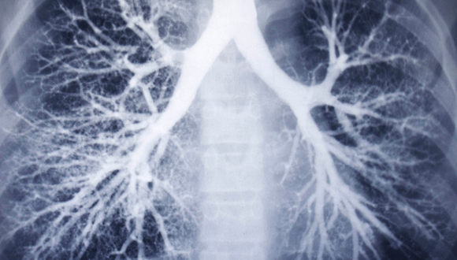
Background
Coronavirus can infect the upper or lower part of the respiratory tract and can sometimes reach all the way down into the alveoli
These signs of respiratory inflammation can be analyzed by doctors by performing a chest Xray or CT scan.
For an infected individual, a chest scan, might seem like “ground-glass opacity” because is looks like frosted glass on a shower door.
Suspected COVID patients need to know their infection status quickly for proper treatment, self isolation and informing close contacts.
Current lab test (RT-PCR) of nose and throat samples take nearly 24 hours
Development of an AI system for the detection of Covid-19 in lungs could help in rapid screening of patients, aiding in speedy detection of the virus which could potentially protect several associated lives by enforcing an early isolation .

Slide 3
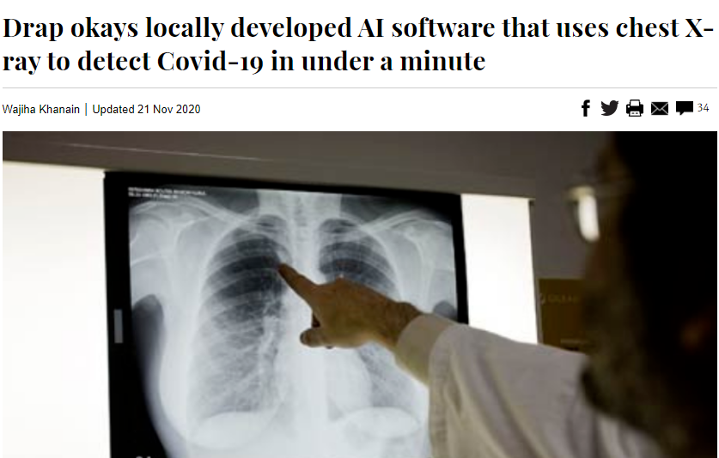
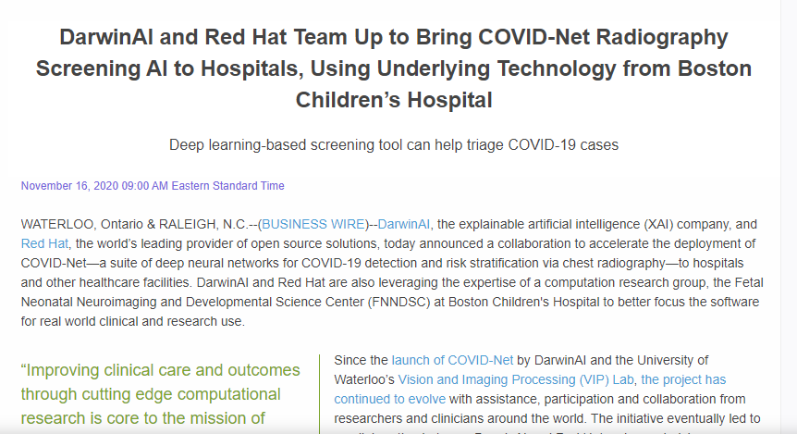
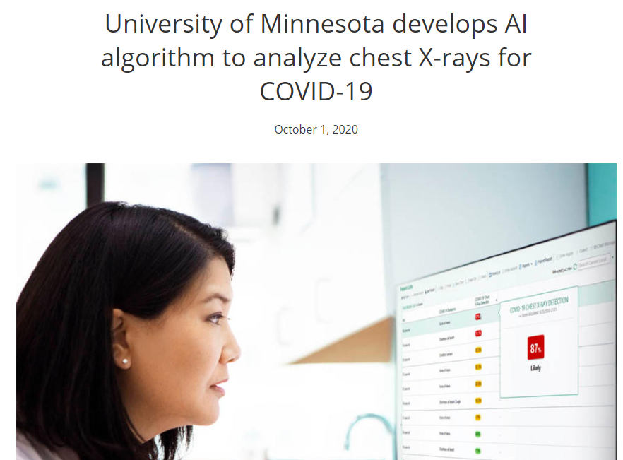
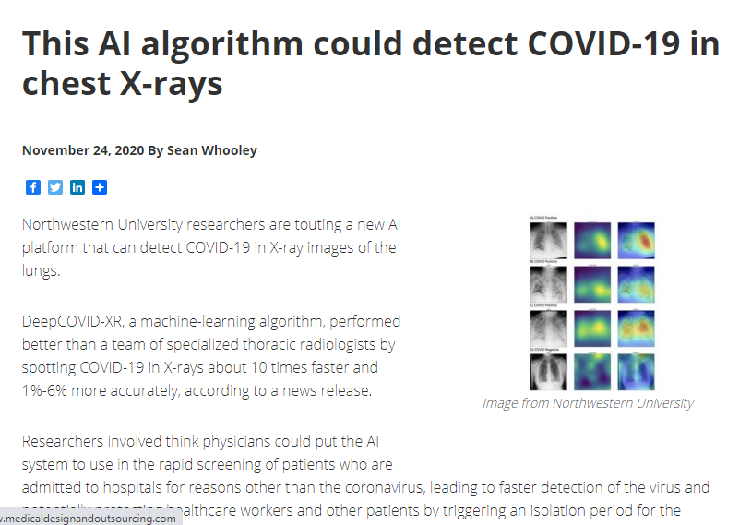
In the News
https://twin-cities.umn.edu/news-events/university-minnesota-develops-ai-algorithm-analyze-chest-x-rays-covid-19
https://www.dawn.com/news/1591603
https://www.medicaldesignandoutsourcing.com/this-ai-algorithm-could-detect-covid-19-in-chest-x-rays/
https://hitinfrastructure.com/news/red-hat-darwinai-partner-for-covid-19-artificial-intelligence
Notes:
Around the world, artificial intelligence (AI) technologies are being rapidly deployed as part of efforts to tackle the coronavirus pandemic.
When Covid-19 was at its height in China, in May, doctors in the city of Wuhan were able to use artificial intelligence (AI) algorithms to scan the lungs of thousands of patients.
few British hospitals are now rolling out AI tools to help medical staff interpret chest X-rays more quickly.
In October 2020, University of Minnesota trained a model using 100,000 X-rays of patients who did not have COVID-19 and 18,000 X-rays of patients who did. Their tool could detect COVID-19 in seconds and display the risk score right away
In November 2020, a locally developed AI model trained with 35,000 CXRs gained approval from Drap – the Drug Regulatory Authority of Pakistan
Again in late November this year, another major breakthrough by the Northwestern University – DeepCOVID-XR could perform better than a team of specialized thoracic radiologists by spotting COVID-19 in X-rays about 10 times faster and 1%-6% more accurately. Accuracy from the radiologists ranged from 76% to 81%, while the algorithm had 82% accuracy.
Red Hat and artificial intelligence (AI) company DarwinAI also recently collaborated to bring a COVID-19 tool to hospitals and healthcare facilities.

Slide 4
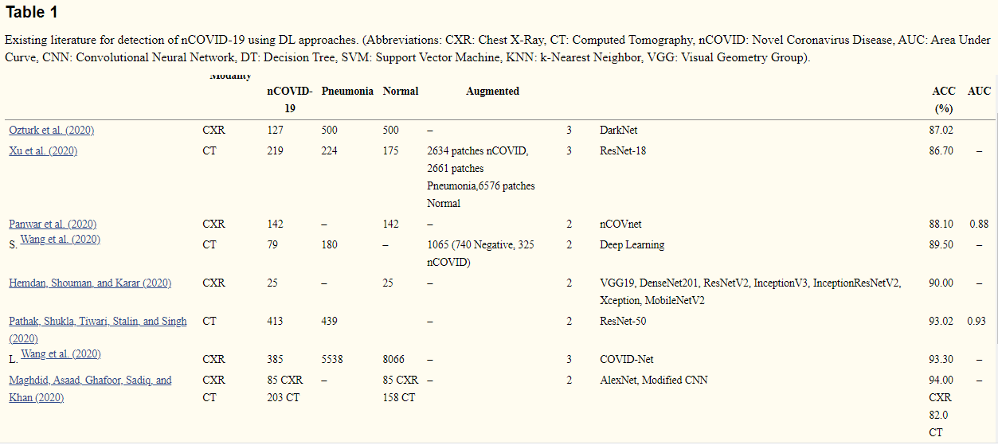
Existing Research
https://www.ncbi.nlm.nih.gov/pmc/articles/PMC7448820/table/t0005/?report=objectonly

Slide 5
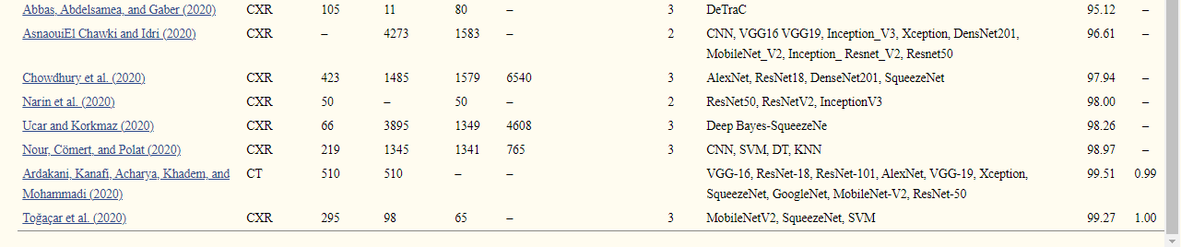
Existing Research
https://www.ncbi.nlm.nih.gov/pmc/articles/PMC7448820/table/t0005/?report=objectonly

Slide 6
Problem Statement
Chest X-Ray (CXR) is the globally accepted standard for performing preliminary investigations of pulmonary ailments in a noninvasive manner.
After retrospective analysis of the various researches of our predecessors, we found that the number of CXR images used in the existing studies were quite limited, which may have led to “under-fitting of the data-hungry DL models“
This project is a preliminary step in the recognition and analysis of Human chest rays for COVID – 19 infections.
We have trained various benchmarked Machine learning models to detect whether an X-Ray image is COVID or non-COVID.

Slide 7
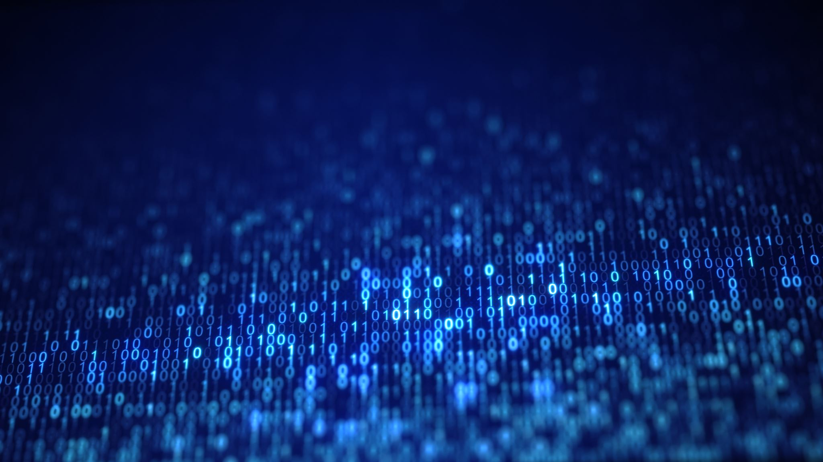
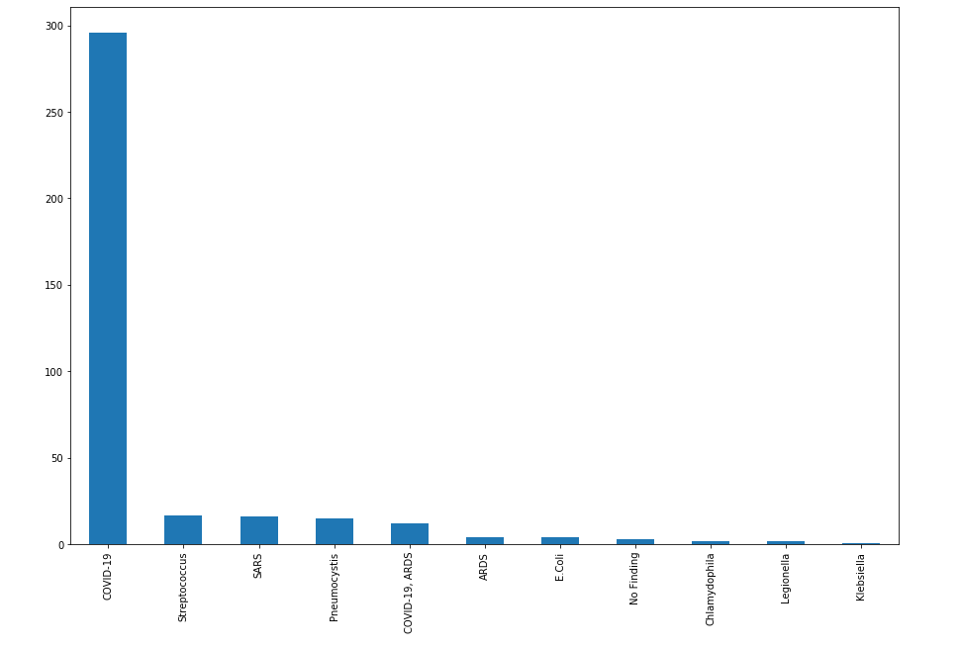
Dataset
Size: 240 MB
296 Covid-19 X-Ray Images
64 Other Respiratory Diseases

Slide 8
Dataset
1GB
219 Covid-19 X-Rays Images
1341 Normal X Rays Images
240MB dataset has more COVID images which result model to be more biased towards COVID images while training the model.
Therefore, train the same model on 1GB dataset which has COVID and non-COVID images.
We reduced 1GB dataset non- COVID images to same number to those of COVID images.

Slide 9
Pre-Processing of data
Image resizing
Data transformation and preprocessing
240MB dataset, images size are different.
Resize all images by computing smallest image size amongst all image
1GB images size are same.
Loading the images using imread from the specified folder
Changing these images to GRAYSCALE images
Normalizing the pixel value of images to 0 or 1
Performed Label encoding technique to normalize the labels

Slide 10
Methods Used
KNN – On 1 Gb dataset
SVM – On 1 Gb dataset
Random Forest – On 1 Gb dataset
CNN without PCA – On Both Datasets
CNN with PCA – On Both Datasets

Slide 11
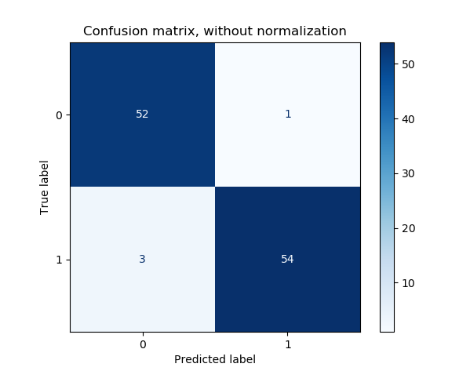
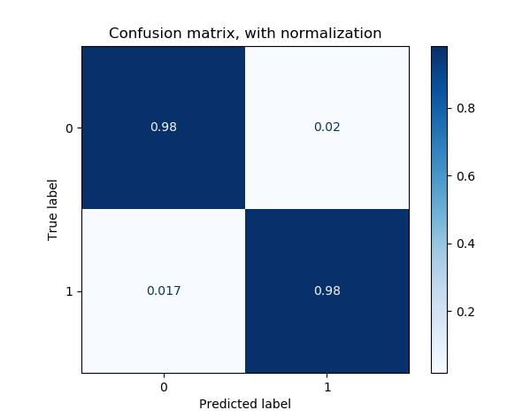
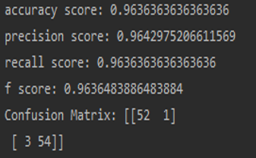
Method 1: KNN

Slide 12
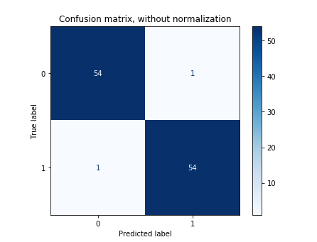
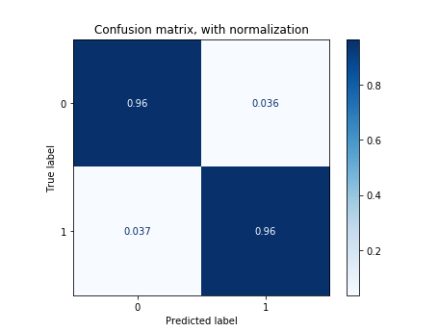
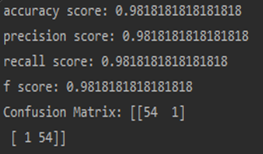
Method 2: SVM

Slide 13
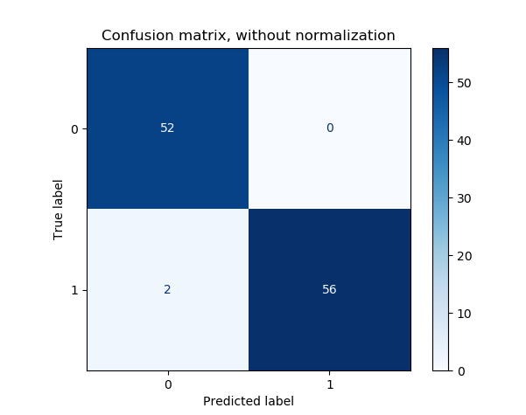
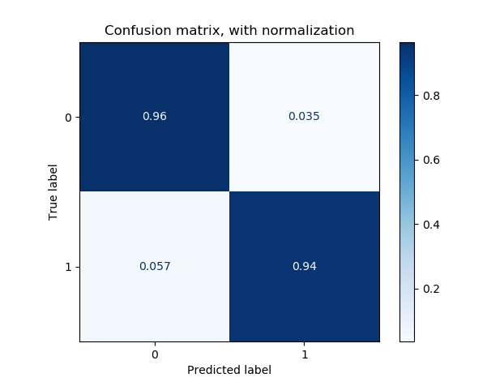
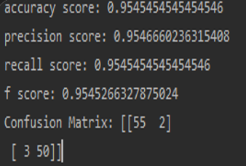
Method 3 : Random Forest

Slide 14
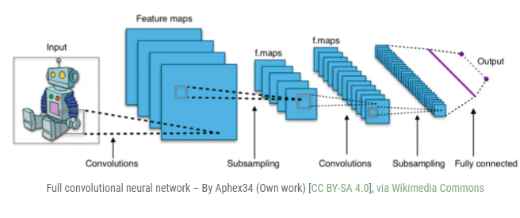
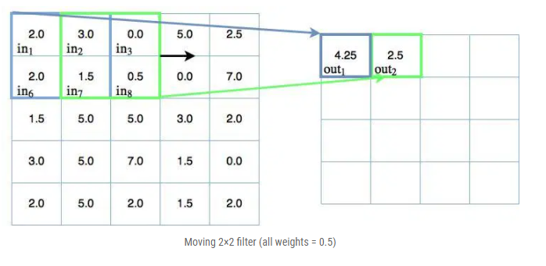
CNN Models
A Convolutional Neural Network (ConvNet/CNN) is a Deep Learning algorithm which can take in an input image, assign importance (learnable weights and biases) to various aspects/objects in the image and be able to differentiate one from the other.
The pre-processing required in a ConvNet is much lower as compared to other classification algorithms.
https://adventuresinmachinelearning.com/convolutional-neural-networks-tutorial-tensorflow/
Notes:
The architecture of a ConvNet is analogous to that of the connectivity pattern of Neurons in the Human Brain and was inspired by the organization of the Visual Cortex. Individual neurons respond to stimuli only in a restricted region of the visual field known as the Receptive Field. A collection of such fields overlap to cover the entire visual area.

Slide 15
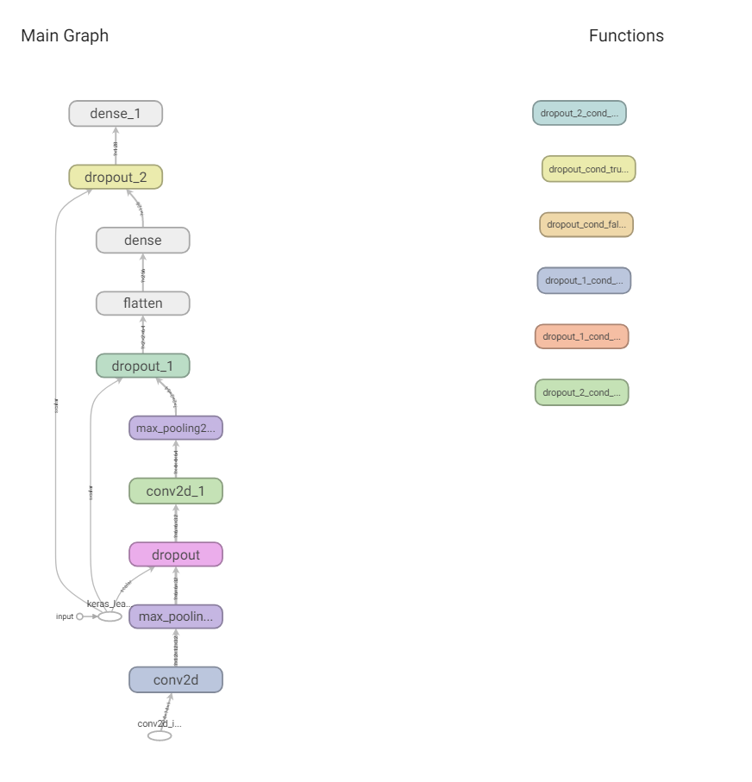
Main Graph for CNN

Slide 16
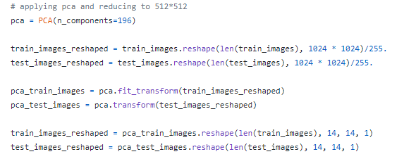
Applying Principal Component Analysis (PCA)
For dimensionality reduction
Chosen all important pixels from the image
Image size in 1GB dataset was 1024x1024x3
Applied PCA by taking n_components as 196 (14x14x1)
Why 196? PCA = min(n_samples, n_features)

Slide 17
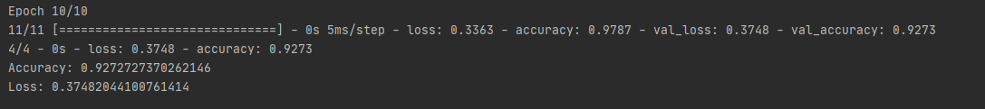

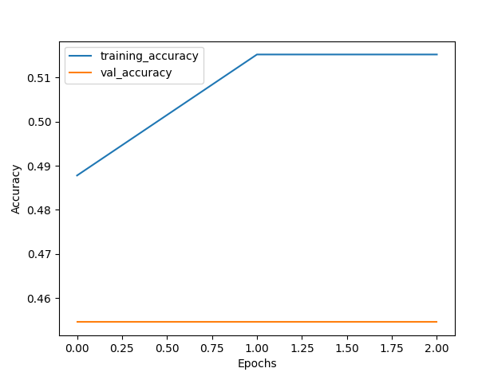
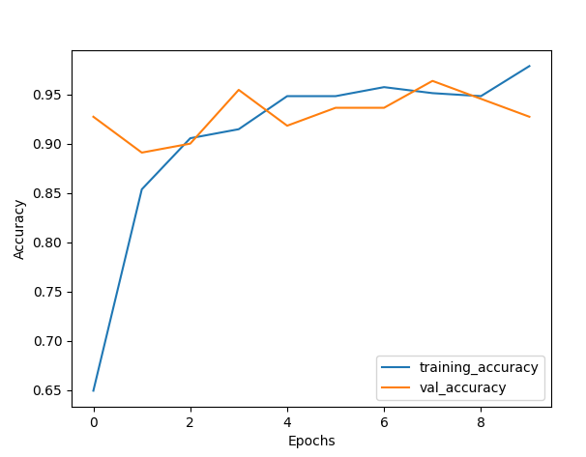
CNN using TensorFlow on 240 Mb dataset – Activation function Relu
Without applying PCA
Applying PCA

Slide 18


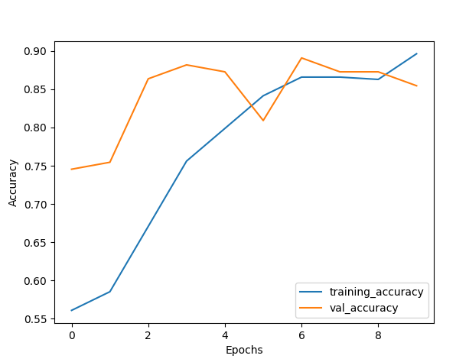
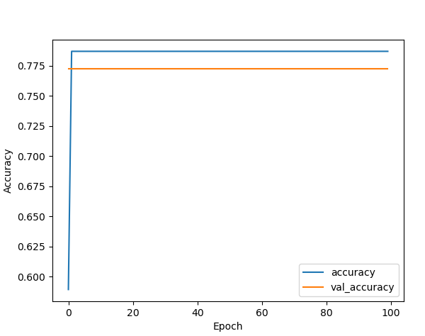
CNN using keras and TensorFlow on 240 Mb dataset - Applying PCA
Epochs = 10
Epochs = 100
Tried 240 MB dataset having PCA activation function from relu to sigmoid. Got accuracy as ~77%

Slide 19
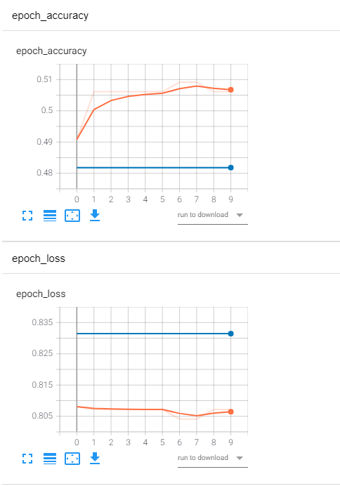
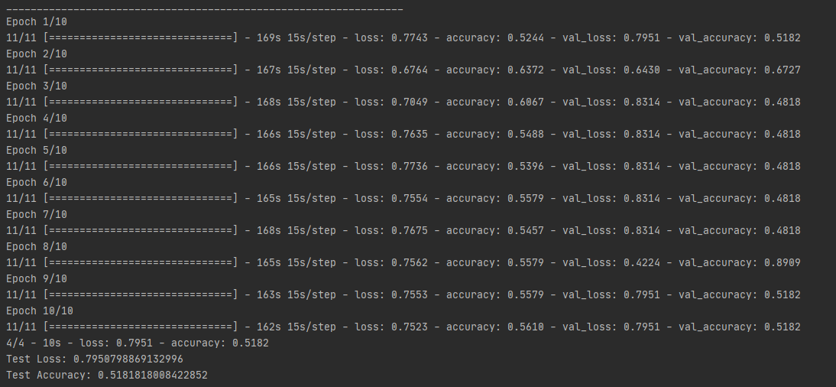
CNN using keras and TensorFlow on 1Gb dataset – Activation function Relu
Without applying PCA

Slide 20
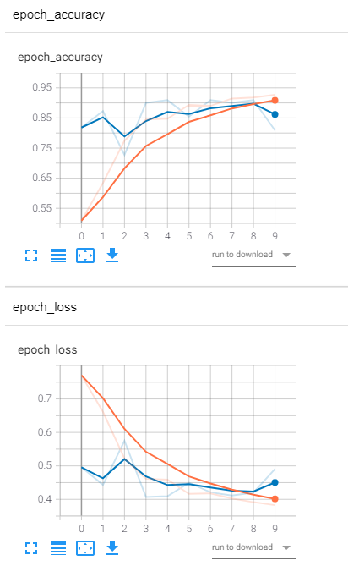
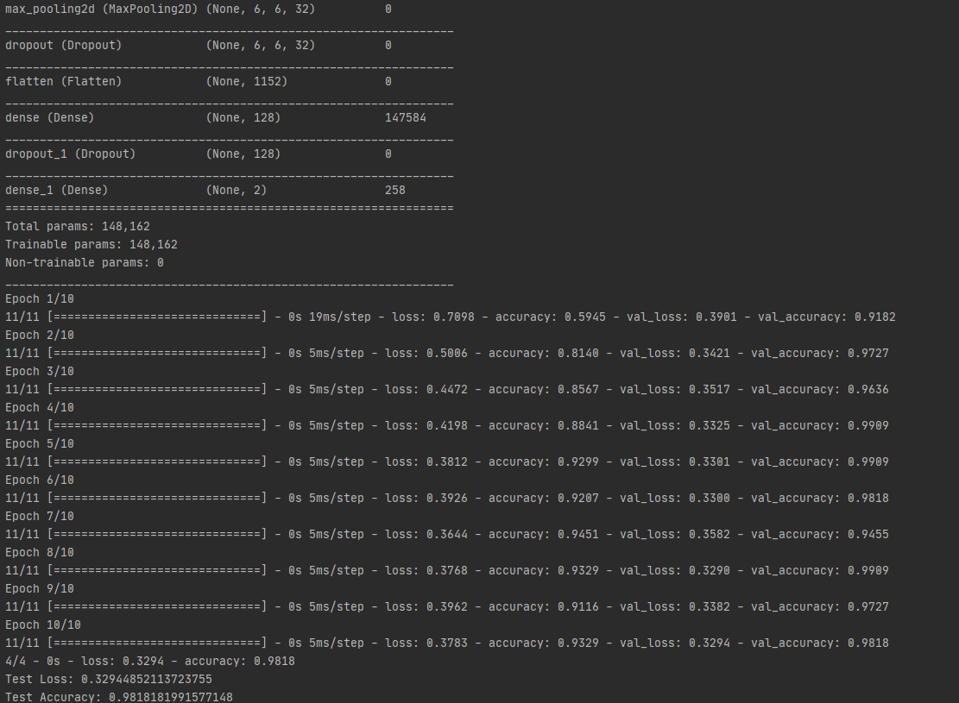
CNN using keras and TensorFlow on 1Gb dataset – Activation function Relu
After applying PCA

Slide 21
Comparing Model Results
Model | Accuracy(%) | Precision(%) | Recall(%) | F1 Score(%)
KNN | 96.36 | 96.42 | 96.36 | 96.36
SVM | 98.18 | 98.18 | 98.18 | 98.18
Random Forest | 95.45 | 95.47 | 95.45 | 95.45
CNN(after PCA) | 98.18 | 98.76 | 98.19 | 98.16

Slide 22
Challenges faced
Issues with initial dataset selection > Insufficient data > Absence of Normal X-Ray Images
Runtime Issues > The RAM size on your systems made it extremely difficult/time consuming to read images > So we decided to convert them to grayscale
Training time with the 1GB dataset was very high

Slide 23
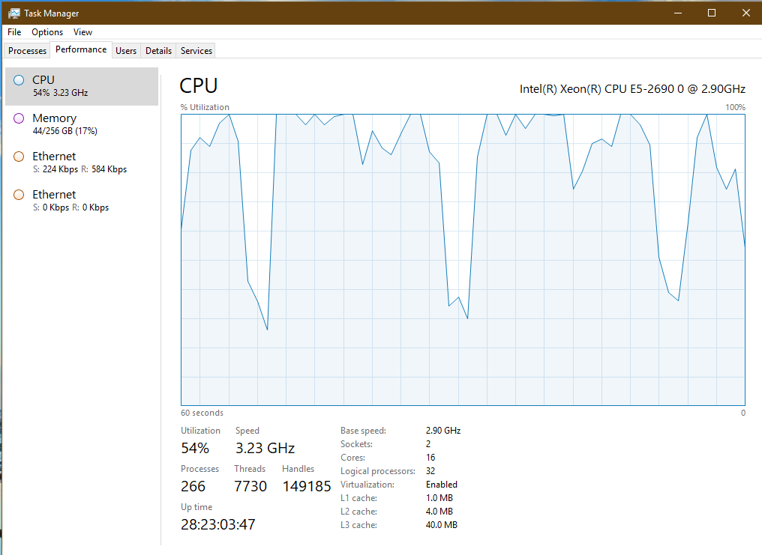
CPU performance without applying PCA

Slide 24
Future Plans/Possibilities
We can add features to our model that would predict the risk factor of the infected patient
Addition of an UI, wherein uploading the Xray would simply classify the image and predict the result

Slide 25

Questions or Comments

